Slide 1

FIFA World Cup Analysis

Slide 2
Introduction
My name is Deepak Gupta and I am work in Unified Mentor Pvt. Ltd. as a Data Scientist intern. I am select this project during the internship because I feel this is a very interesting project for learn something new skills for my future. This project is related to Sports domain.
The FIFA World Cup is a quadrennial tournament that determines the men’s world champion in football (soccer). The Federation International of Football Association (FIFA), the sport’s global governing body, organizes the events, which features 32 men’s national teams. The tournament begins with a qualifications phase that takes over the three years prior to the event to determine which teams complete in the tournament phase. The first FIFA World Cup was held in Uruguay in 1930, and as of 2022, 22 final tournaments have been held , with 80 national teams completing in total.

Slide 3
Project Details
Project Title | FIFA World Cup Analysis
Technologies | Data Science
Domain | Sports
Project Difficulties Level | Advanced
Tools | Python (Jupiter Notebook), Microsoft PowerBI, Microsoft Power Point, and Microsoft Excel

Slide 4
Objective of the Project
It aims to inspire change and broaden the scope of the game of billions around the world. The World Cup is more then just a football tournament, it is a place where crowds become communities.
FIFA World Cup analysis can cover a variety of topics, including:-
Goals: Number of goals per game, goals per team, and goals scored by country
Clean sheets: Number of clean sheets in a tournament
Attendance: Number of teams, matches, and stadiums with the highest average attendance.
Location: Precise geolocation date

Slide 5
Problem Statement
With FIFA is in the blood of many people of the world. You are tasked to tell the story of unsung analysts who put great efforts to provide accurate data to answer every question of fans. The FIFA World Cup is a global football competition contested by the various football-playing nations of the world. It is contested every four years and is the most prestigious and important trophy in the sport of football.
The World Cups dataset shows all information about all the World Cups in history, while the World Cup Matches dataset shows all the results from the matches contested as part of the cups. Find key metrics and factors that influence the World Cup win. Do your own research and come up with your findings.

Slide 6
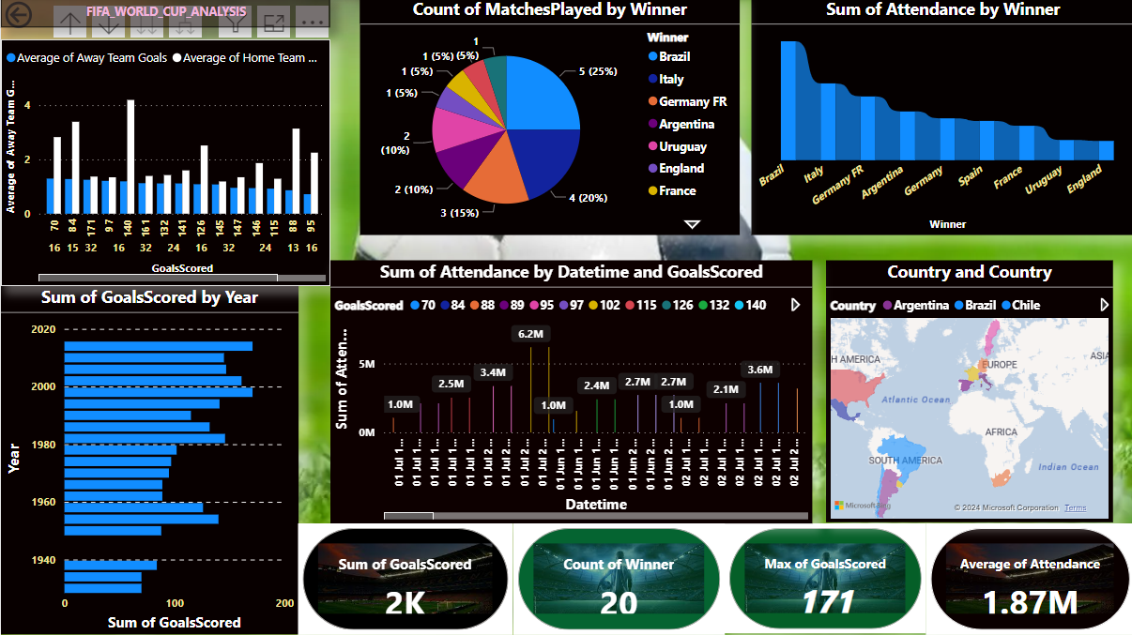
Overview of the Project

Slide 7
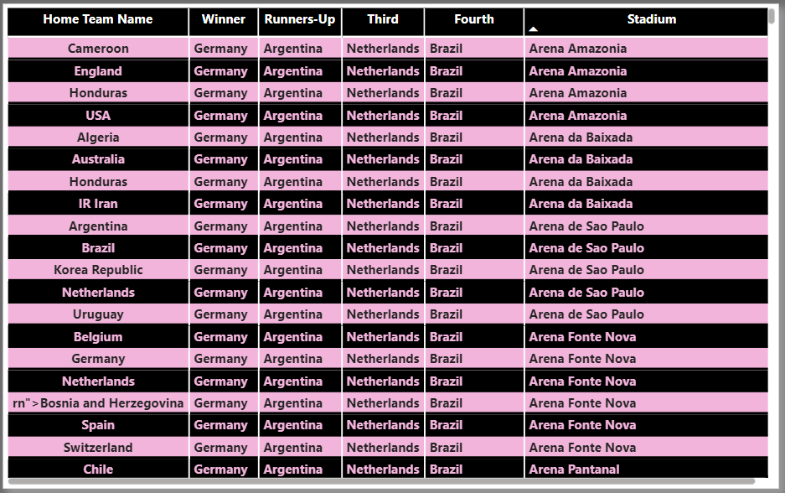
Winners Analysis in World Cup

Slide 8
Important Insights of the Project
Brazil has won the tournament most number of times.
A complete depiction of number of World Cups won, first runner-up, and second runner-up positions by various participating teams.
Brazil scored the most number of goals throughout the history of World Cup followed by Argentina and Germany.
Brazil has again scored a majority of total goals playing as home team whereas Spain scored more goals playing as away country rather than home country.
73.6% of the matches were won by home team while 26.4% were won by away team.
Brazil has played the most number of players followed by Italy and Argentina.
Most of the teams have played between 0 and 500 players only in the complete competition, and handful of countries have played more than 1500 players in the history of competition.

Slide 9
Conclusion of the Project
When analyzing each tournament separately, we can observe distinct strengths and weaknesses in both the men’s and women’s game. While possession-dominant teams have achieved success in the women’s competition, they have shown relatively less effectiveness in the men’s tournament. Conversely, defensive styles of play have yielded better results in the men’s tournament compared to the women’s. However, it is important to note that these observations should probably be seen as a temporary phenomenon rather than a universal truth. Football is a constantly evolving sport, often cyclical in nature. Tactical trends come and go as teams continue to adapt and evolve their strategies to stay competitive. The results of this study indicate that teams in the men’s competition are currently lagging behind in effective ball possession strategies, while teams in the women’s competition need to develop more effective solutions when applying a low-possession approach.

Slide 10
Thank You
Detailed Project Report Submitted by
Deepak Gupta

